Slide 1
Match Five!
Answers…

Slide 2
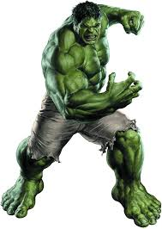
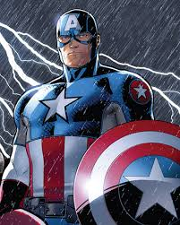
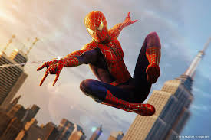
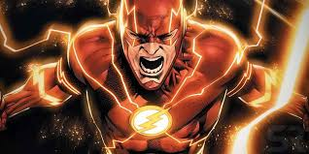
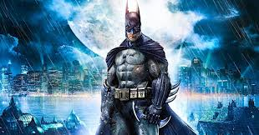
01. Superheroes
B
1 Barry Allen
2 Bruce Banner
3 Bruce Wayne
4 Peter Parker
5 Steve Rogers
A
C
1 D
2 B
3 E
4 C
5 A
D
E

Slide 3
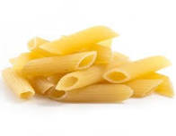
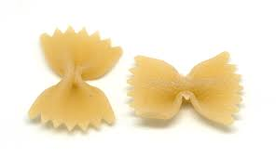
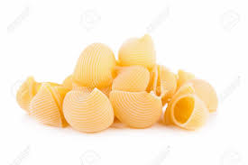
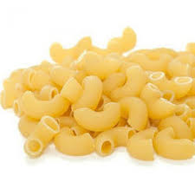
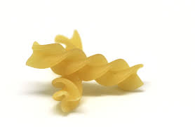
02. Pasta
B
1 Conchiglie
2 Farfalle
3 Fusilli
4 Macaroni
5 Penne
A
C
1 C
2 A
3 D
4 E
5 B
D
E

Slide 4
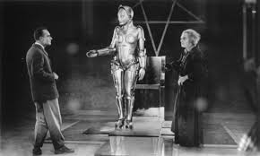
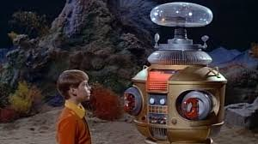
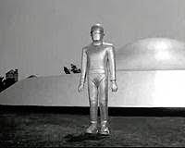
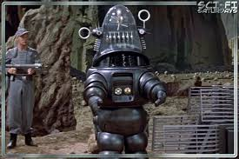
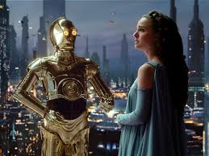
03. Movie Robots
B
1 Forbidden planet
2 Lost in Space
3 Metropolis
4 Star Wars
5 The Day the Earth Stood Still
A
C
1 D
2 A
3 B
4 E
5 C
D
E

Slide 5
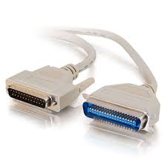
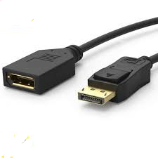
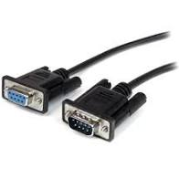
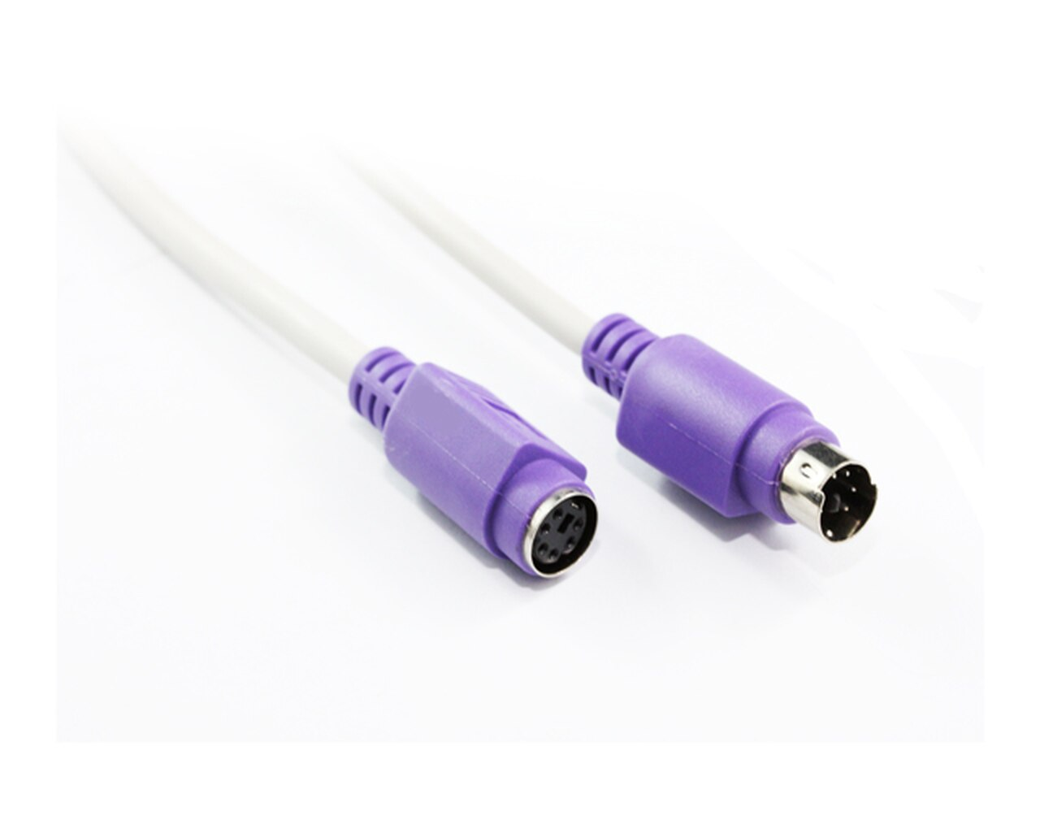
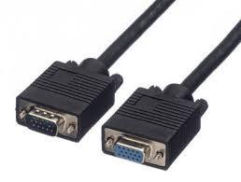
04. Computer Connectors
B
1 Centronix
2 DisplayPort
3 PS/2
4 Serial (RS232)
5 VGA
A
C
1 B
2 A
3 E
4 C
5 D
D
E

Slide 6
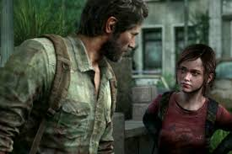
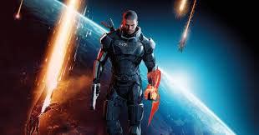

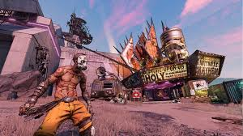
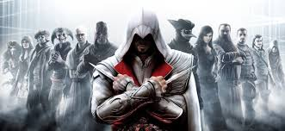
05. Video games
B
1 Assassins Creed
2 Borderlands
3 Last of Us
4 Mass Effect
5 Tomb Raider
A
C
1 E
2 D
3 B
4 A
5 C
D
E

Slide 7
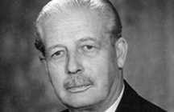
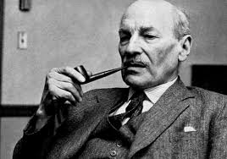
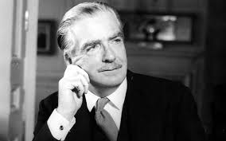
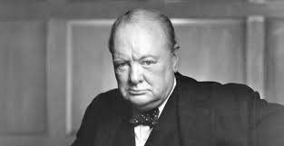
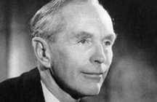
06. Mid-twentieth Century Prime ministers
B
1 Alec Douglas-Home
2 Antony Eden
3 Clement Attlee
4 Harold Macmillan
5 Winston Churchill
A
C
1 E
2 C
3 A
4 B
5 D
D
E

Slide 8

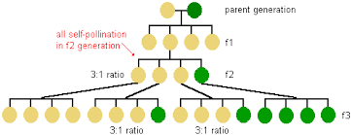
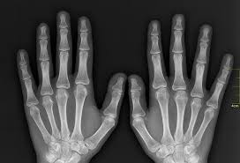
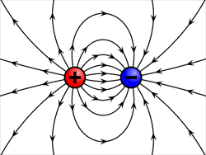

07. Nineteenth Century Scientists
B
1 Boltzmann
2 Maxwell
3 Mendel
4 Pasteur
5 Röntgen
A
C
1 D
2 E
3 A
4 B
5 C
D
E

Slide 9
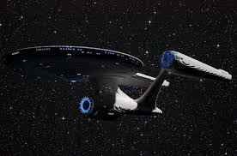
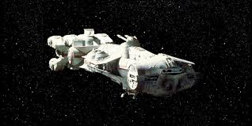
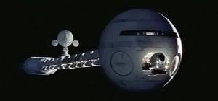
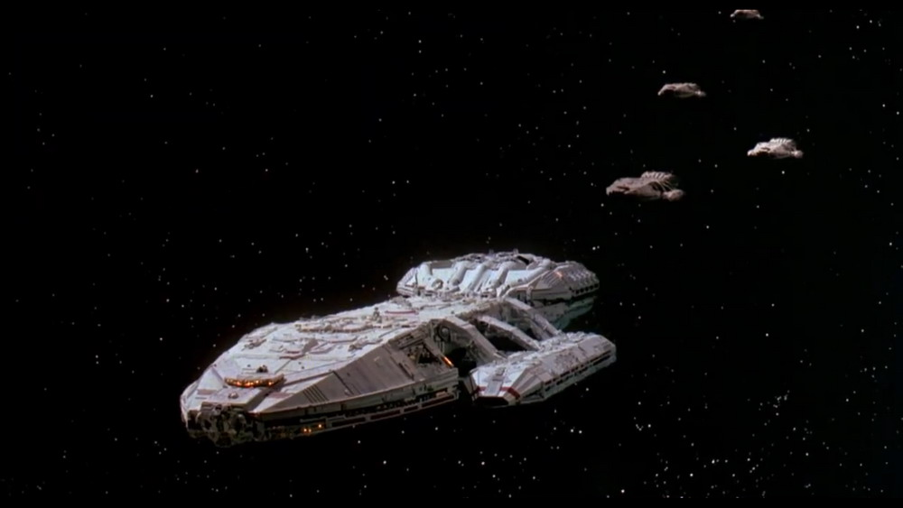
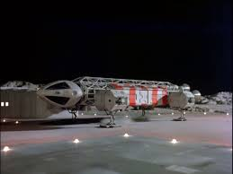
08. Spaceships ca. 1970
B
1 Battlestar Galactica
2 Discovery one
3 Eagle
4 Enterprise
5 Tantive IV
A
C
1 D
2 C
3 E
4 B
5 A
D
E

Slide 10
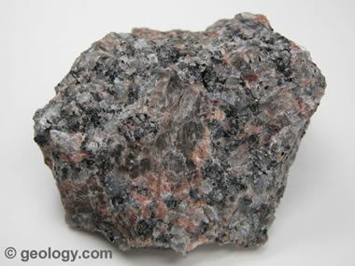
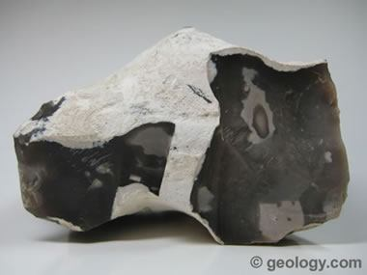
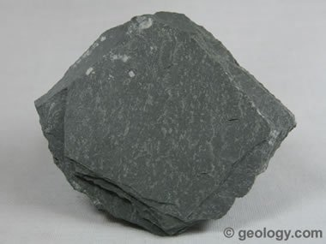
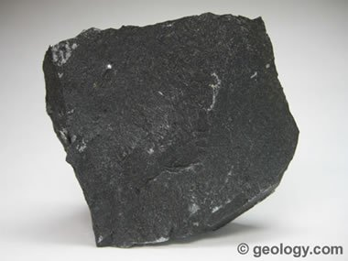
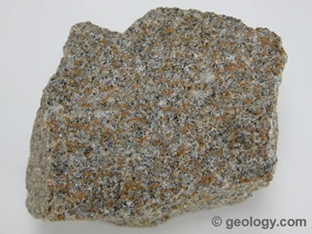
09. Rocks
B
1 Basalt
2 Granite
3 Flint
4 Sanstone
5 Slate
A
C
1 D
2 B
3 A
4 E
5 C
D
E

Slide 11
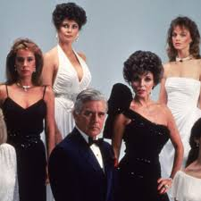
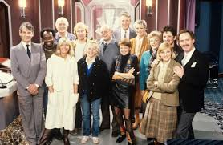
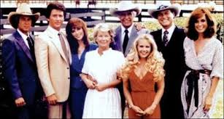
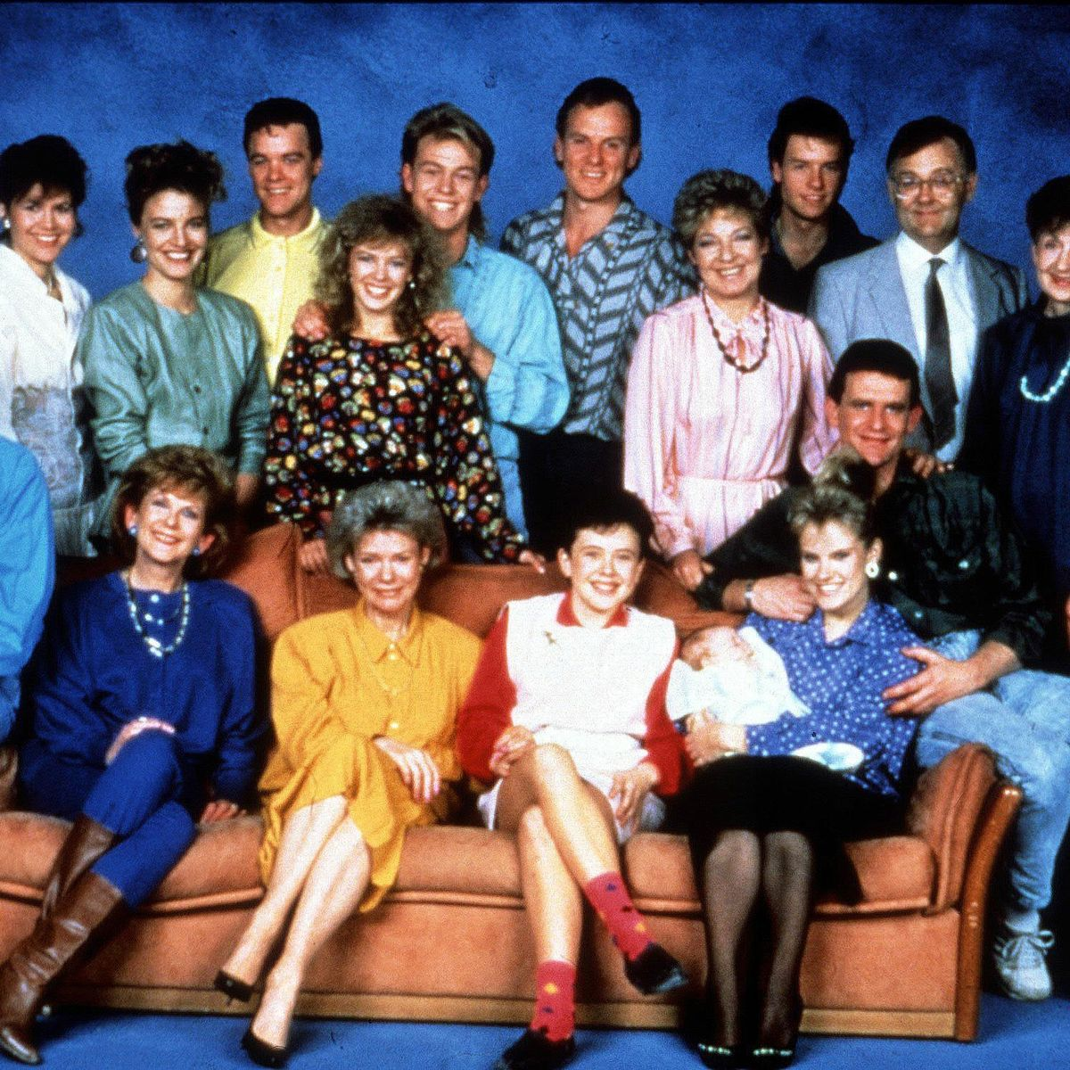
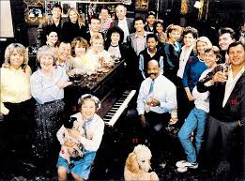
10. Soap Operas ca. 1980
B
1 Crossroads
2 Dallas
3 Dynasty
4 Eastenders
5 Neighbours
A
C
1 B
2 C
3 A
4 E
5 D
D
E

Slide 12





11. World Religions
B
1 Buddism
2 Confucianism
3 Hinduism
4 Shintoism
5 Toaism
A
C
1 B
2 C
3 D
4 E
5 A
D
E

Slide 13
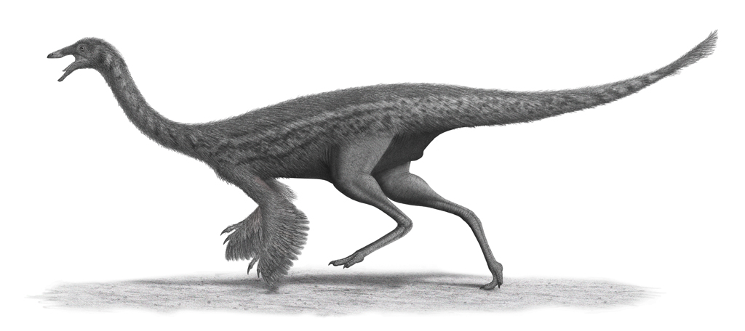
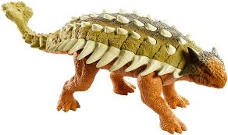
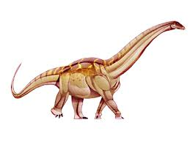


12. Dinosaurs
B
1 Allosaurus
2 Ankylosaurus
3 Gallimimus
4 Styracosaurus
5 Titanisaurus
A
C
1 D
2 B
3 A
4 E
5 C
D
E

Slide 14





13. Australian Fauna
B
1 Bandicoot
2 Koala
3 Quokka
4 Tasmanian devil
5 Wombat
A
C
1 C
2 E
3 D
4 B
5 A
D
E

Slide 15




14. Halogens
B
1 Astatine
2 Bromine
3 Chlorine
4 Fluorine
5 Iodine
A
C
1 E
2 C
3 B
4 A
5 D
D
E
???

Slide 16





15. Boy bands
B
1 *NSYNC
2 Bay City rollers
3 Bros
4 One direction
5 Take That
A
C
1 E
2 A
3 D
4 B
5 C
D
E

